Slide 1
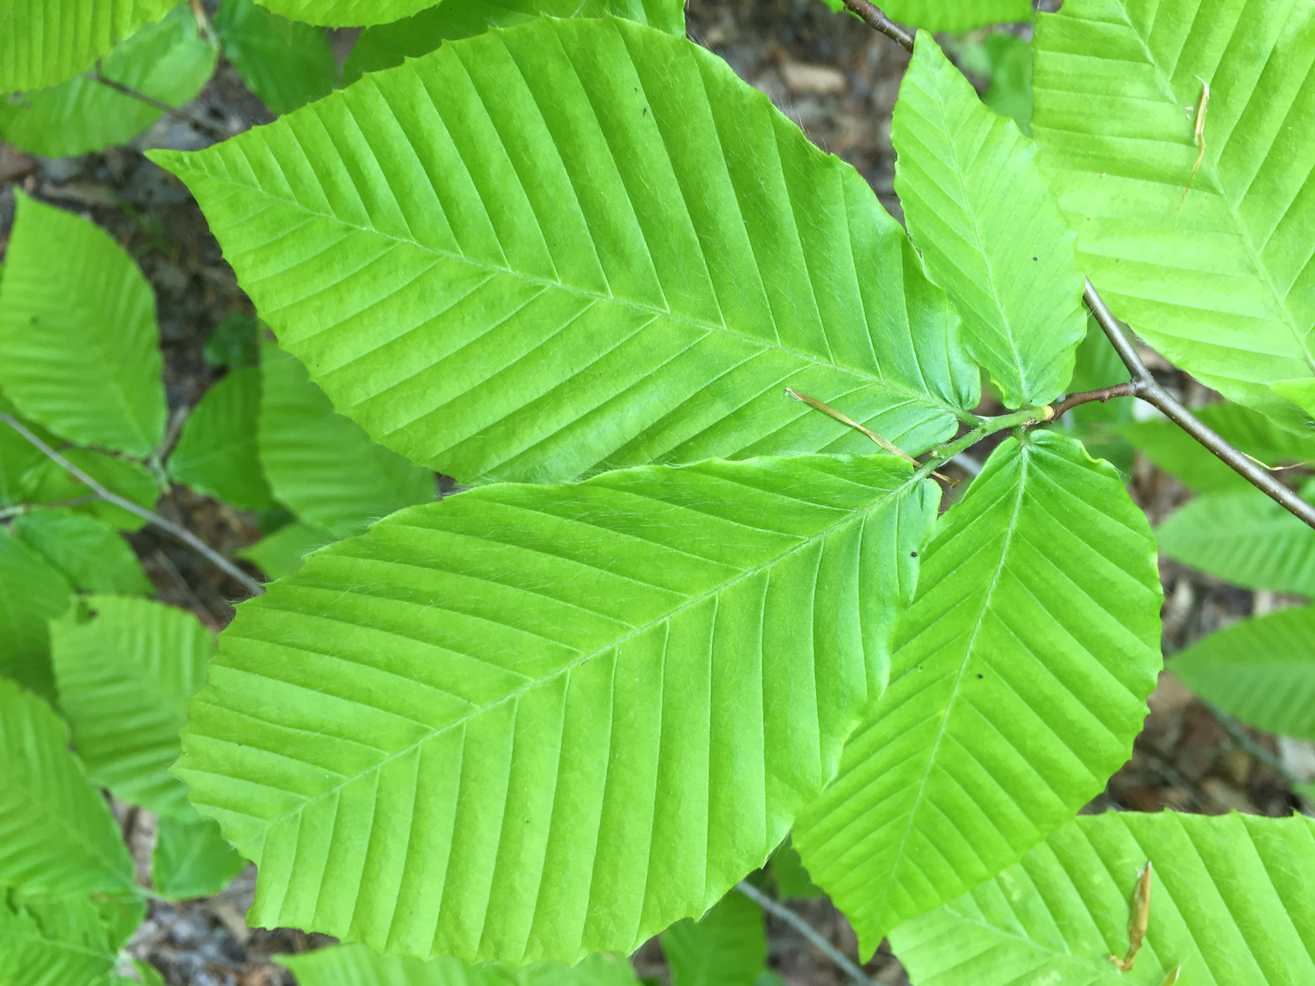


Rethinking False Spring
Catherine Chamberlain
Arnold Arboretum | Harvard University

Slide 2
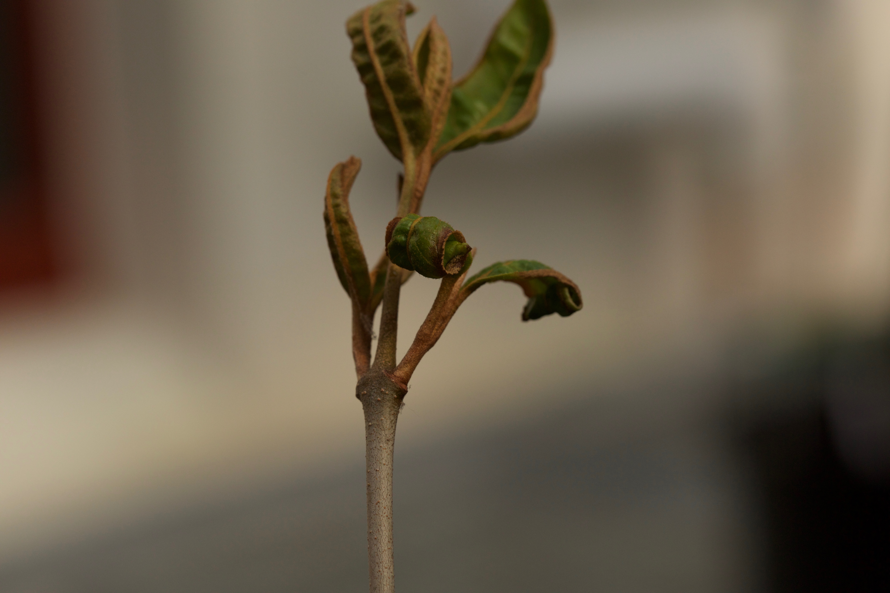
OUTLINE
Quick review of False Spring
Talk about Buds Experiment: initial results
Field Freezing experiment
Regional Risk: maps and ideas
Questions

Slide 3
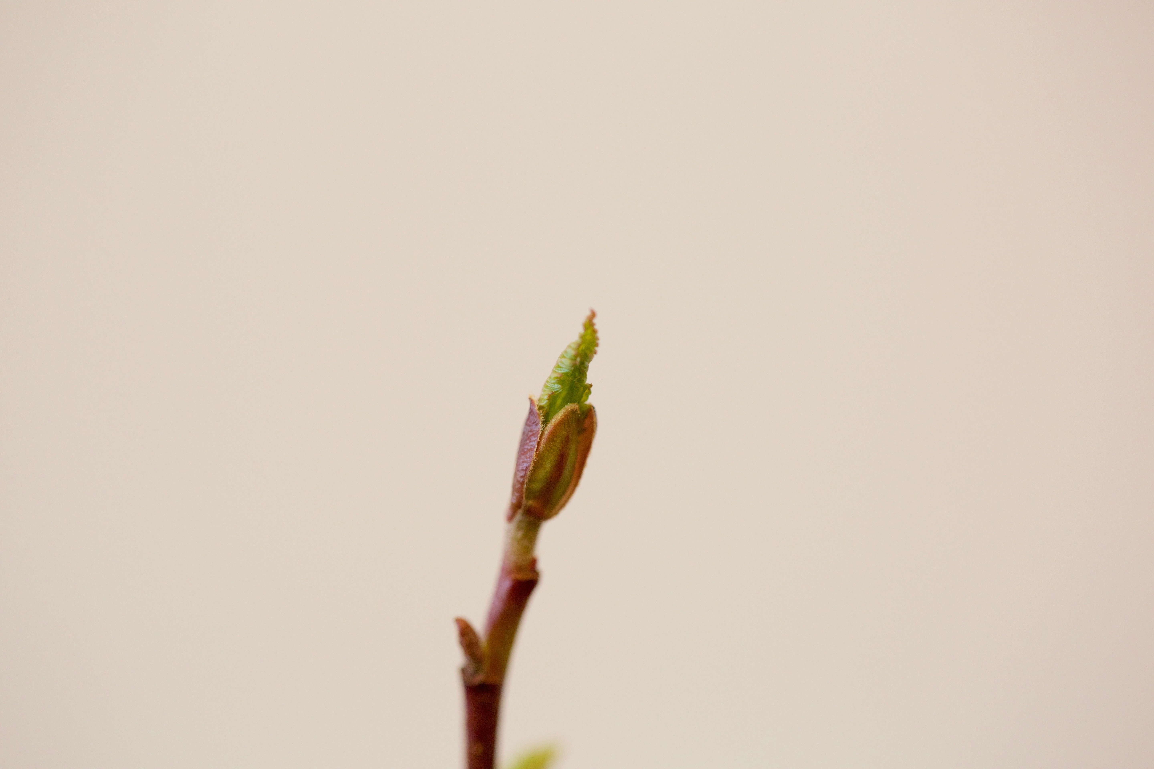
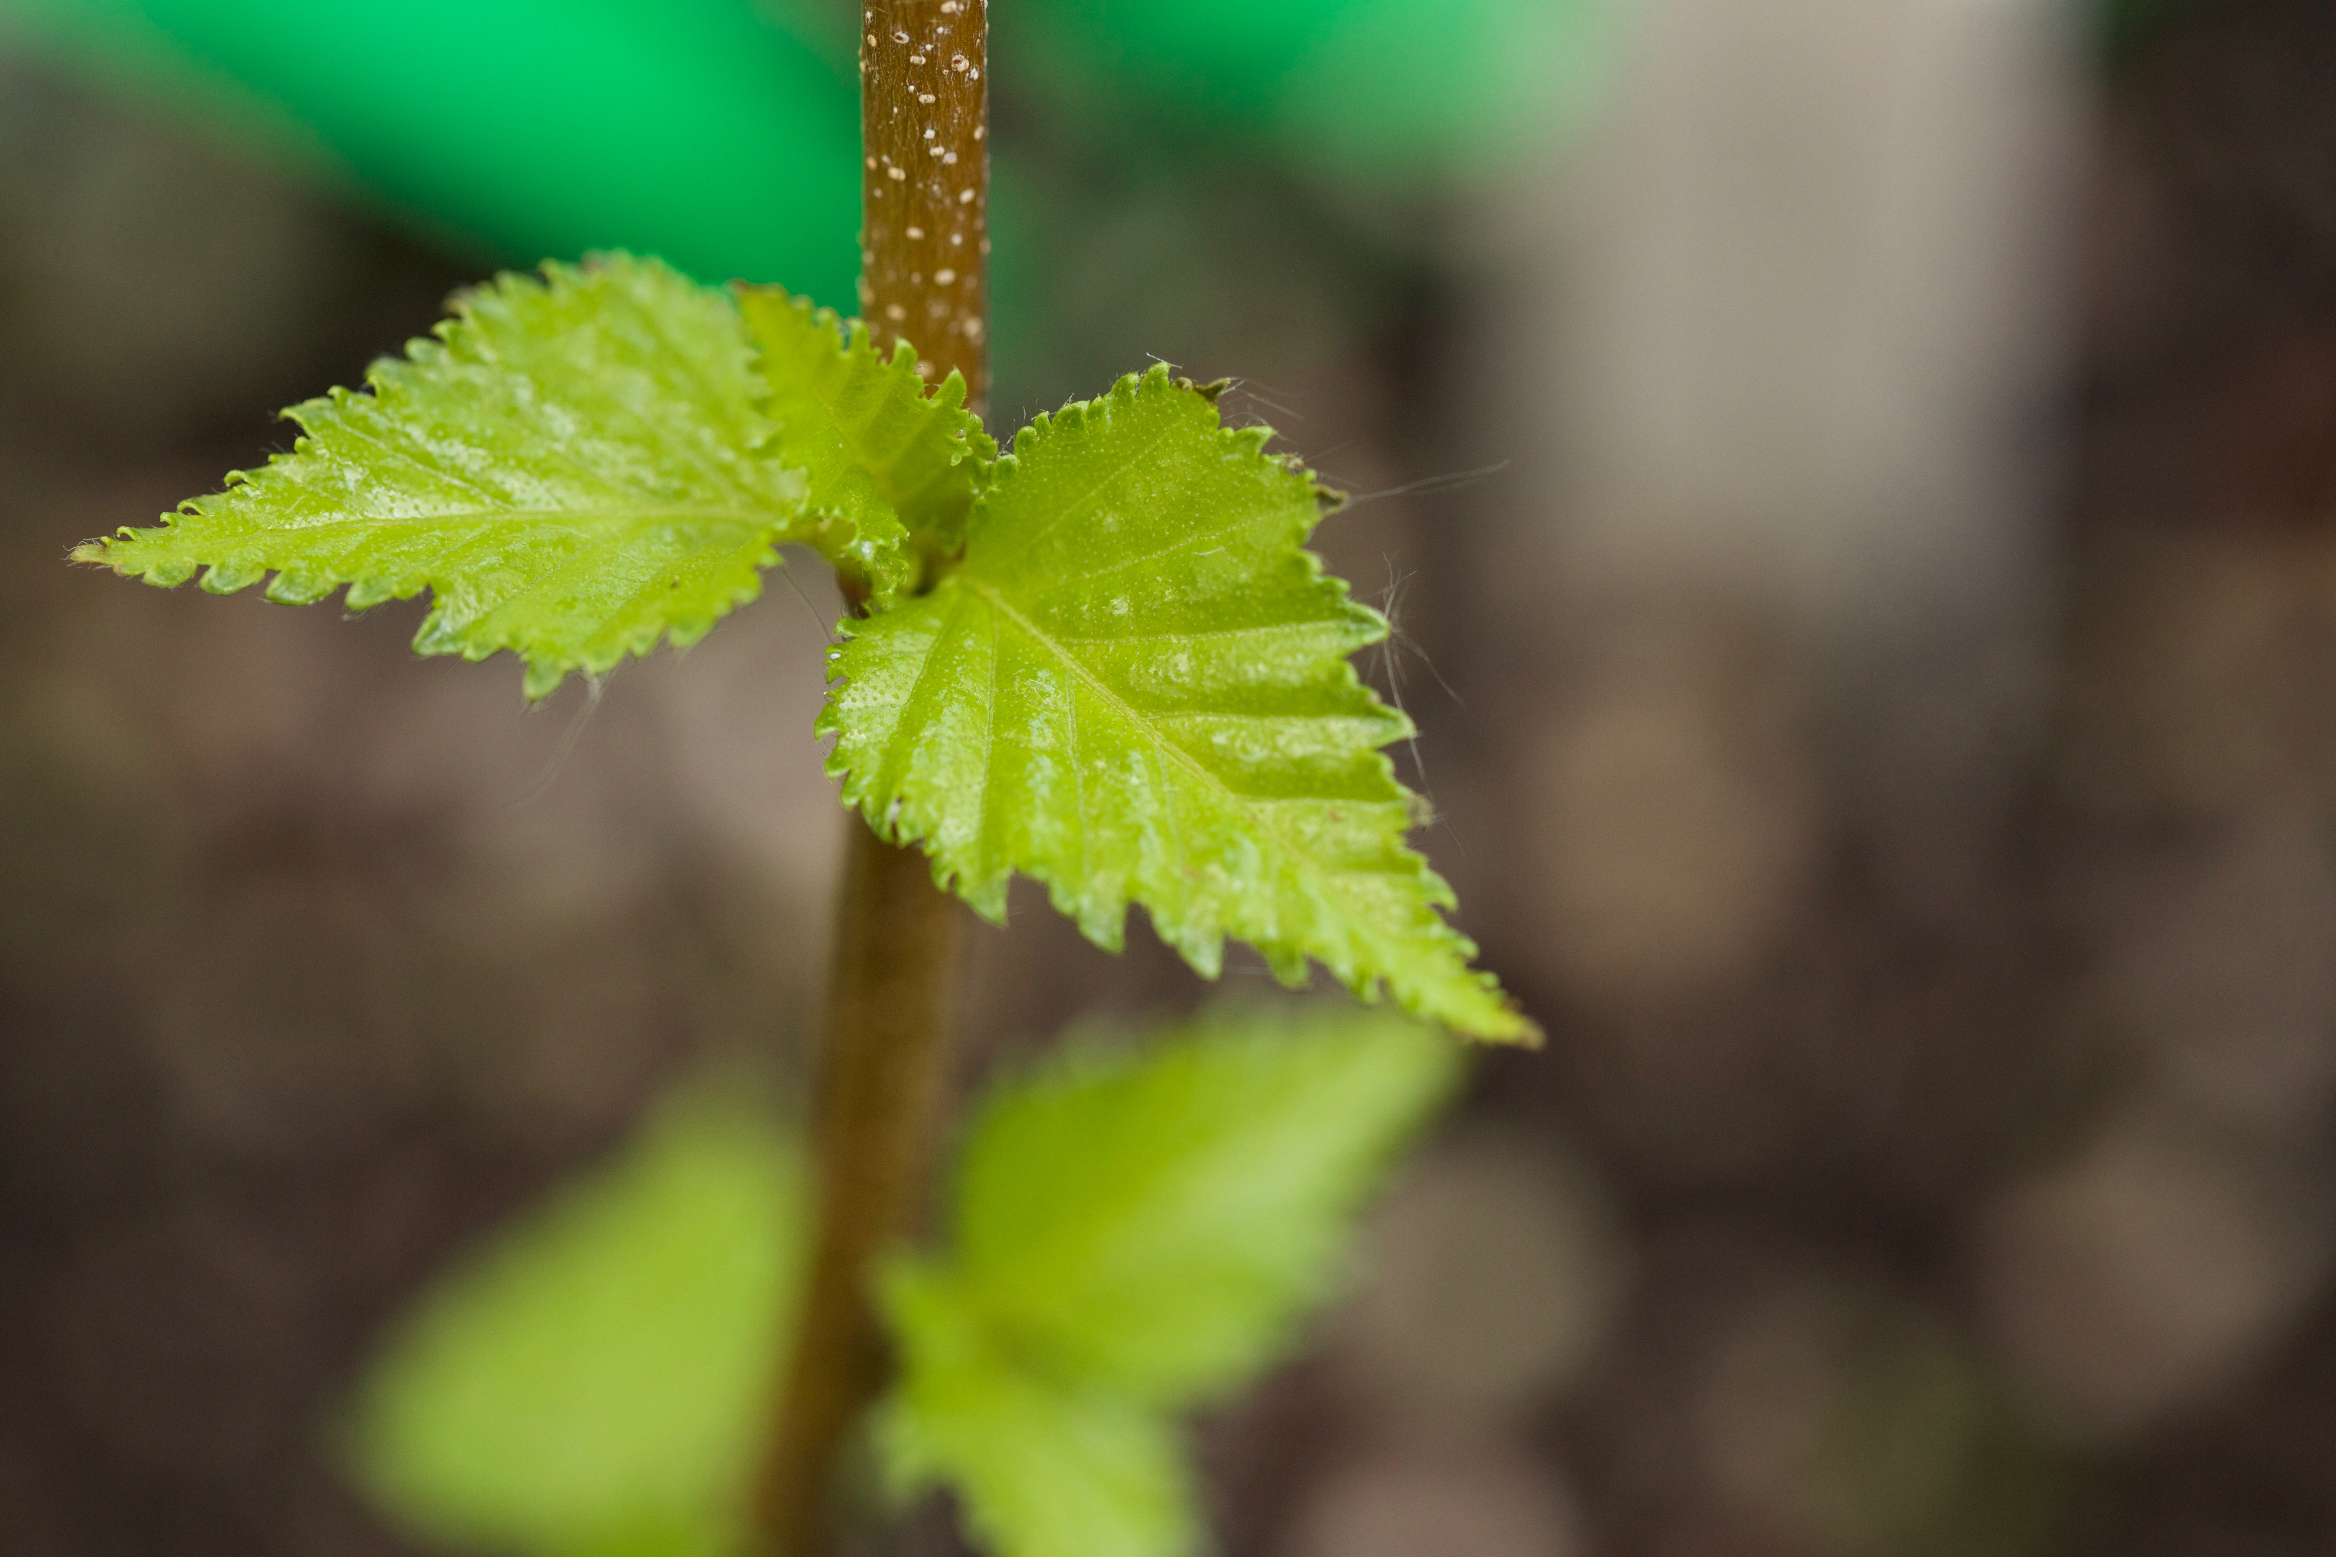
Alnus incana - budburst
False Spring Risk
Interested in time between leaf budburst and leafout,
when frost tolerance is lowest but risk is high.
BUDBURST
LEAFOUT
DURATION OF VEGETATIVE RISK
Betula populifolia - leafout

Slide 4
STRATEGIES:
Avoidance
Tolerance

Slide 5
STRATEGIES:
Avoidance
Tolerance
DVR
DVR

Slide 6
STRATEGIES:
Avoidance
Tolerance
DVR
Serrations along leave margins
DVR

Slide 7
STRATEGIES:
Avoidance
Tolerance
DVR
Trichomes on young leaves
Serrations along leave margins
DVR

Slide 8
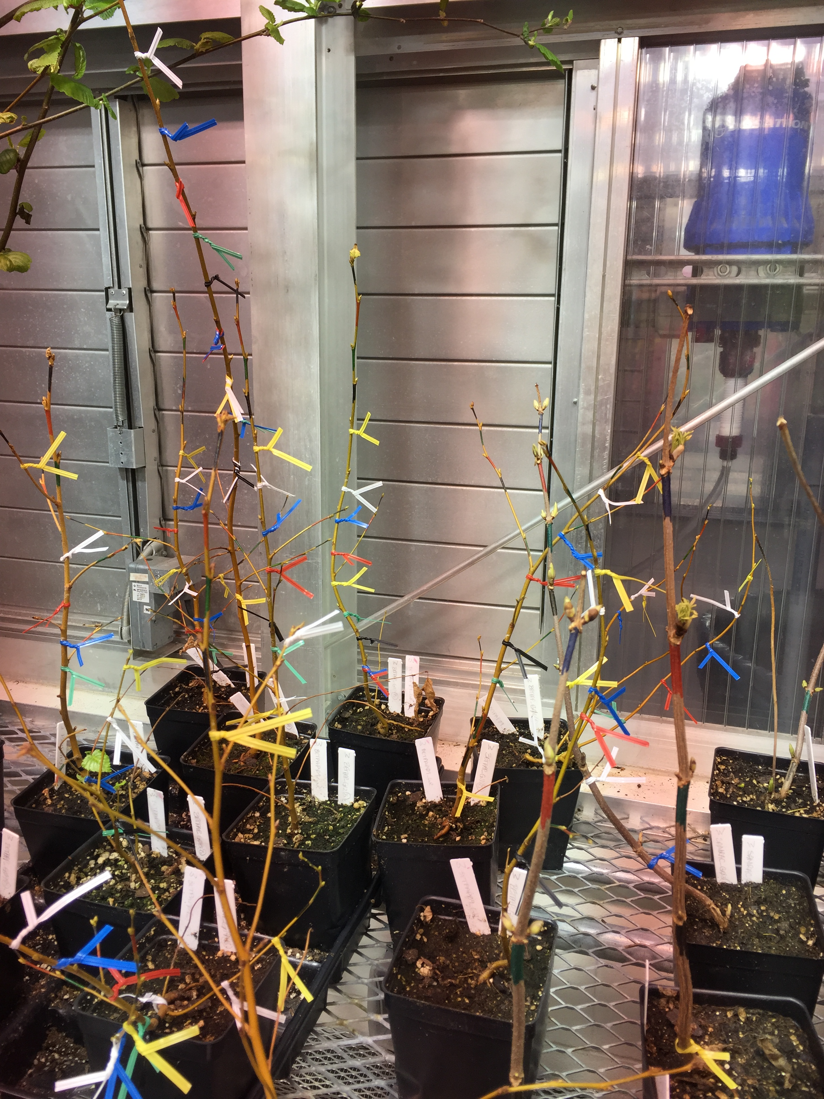
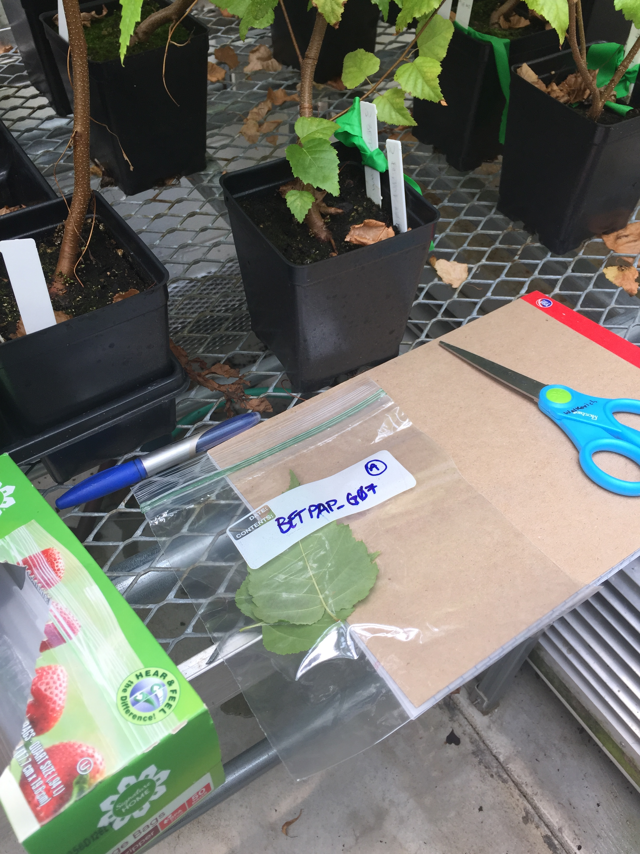
Buds Experiment
Freezing Experiment with Greenhouse individuals

Slide 9
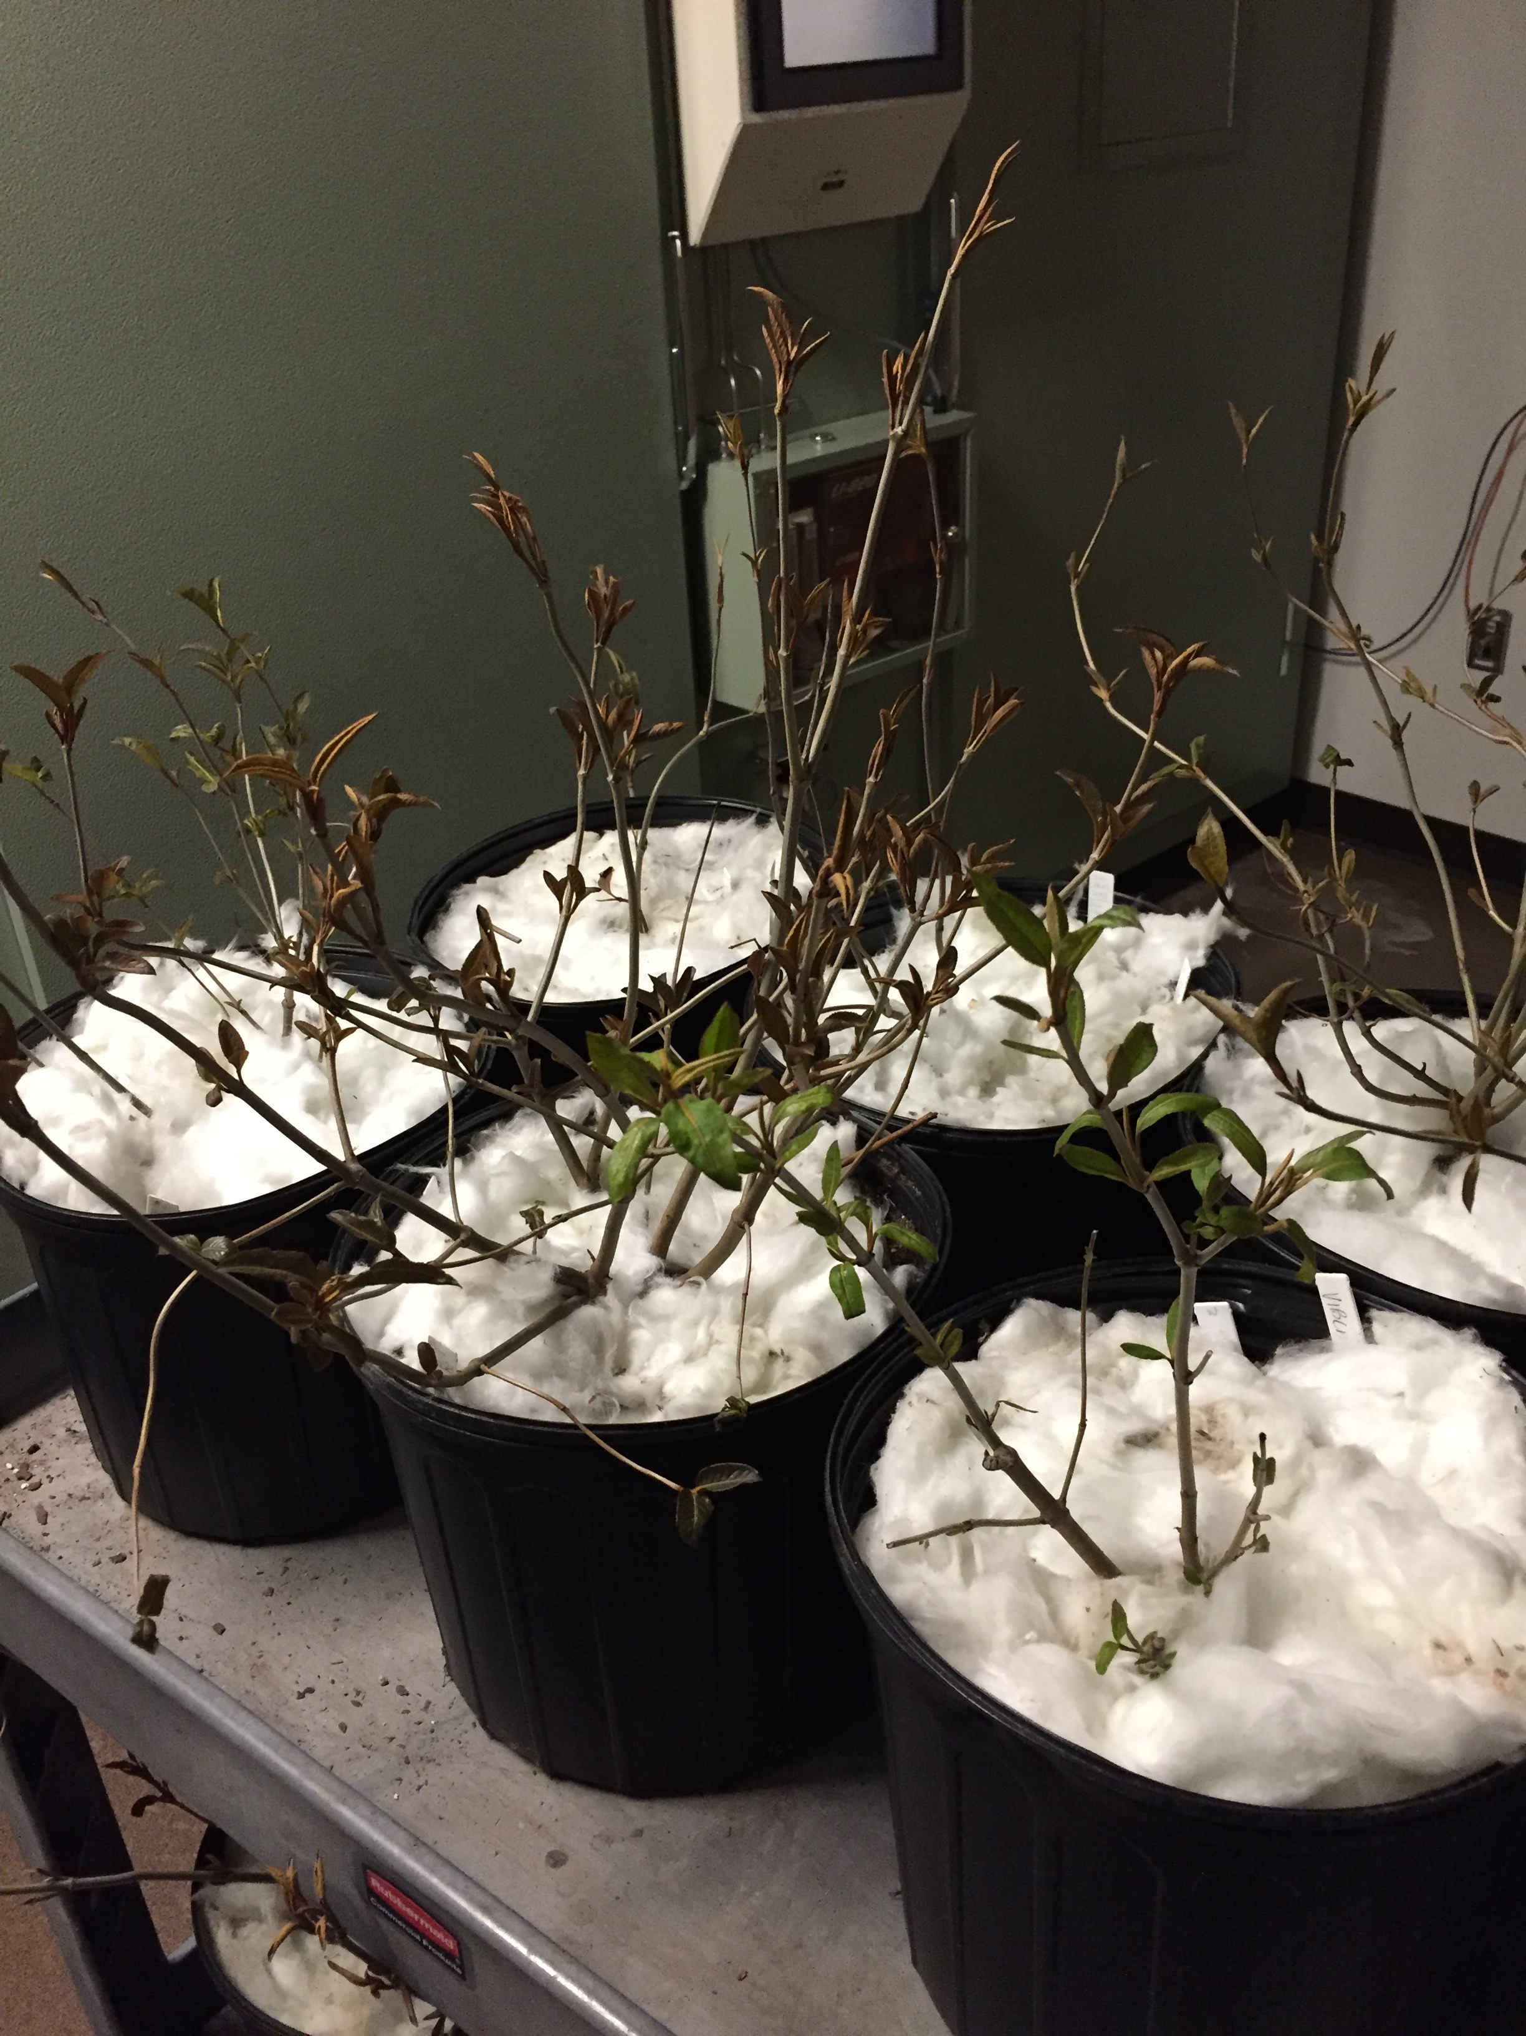
EXPERIMENT LAYOUT
SPECIES:
ACESAC
ACEPEN (?)
QUEALB
QUERUB
POPGRA
ILEVER
LONCAN
ALNINC
BETALL
FAGGRA (?)

Slide 10
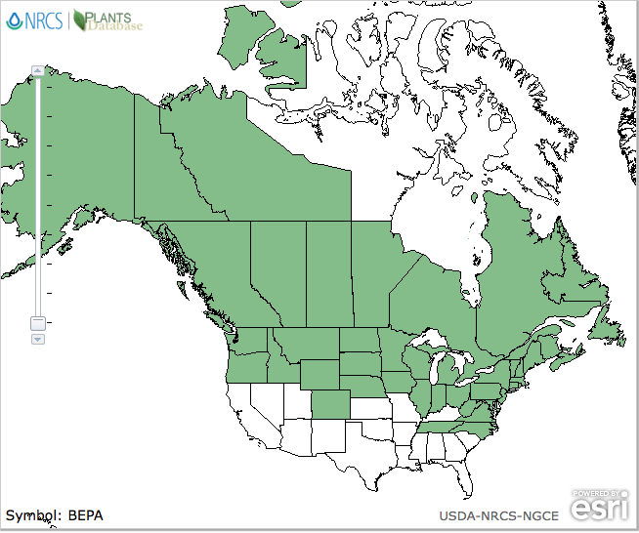
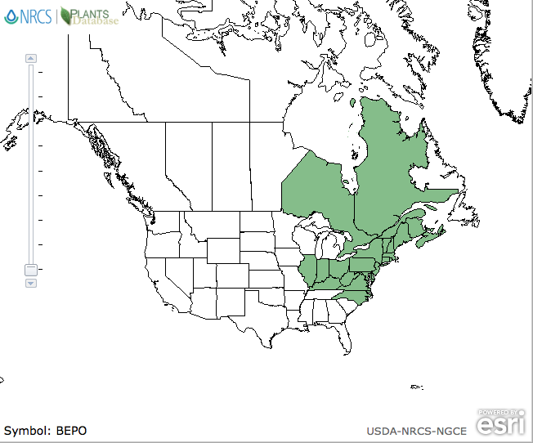
BETPAP
BETPOP
BETPAP
BETPOP

Slide 11
Species: 2-3 (BETPAP, BETPOP, SAMRAC)
Individuals: 14-18
Buds: 6-36
TX: Control vs. Freeze
dvr ~ tx + species + (1|individual)
DVR: Duration of Vegetative Risk

